Slide 1

Falco para seguridad en kernel de host y contenedores

Slide 2
Operativa de Falco en Kernel

Slide 3
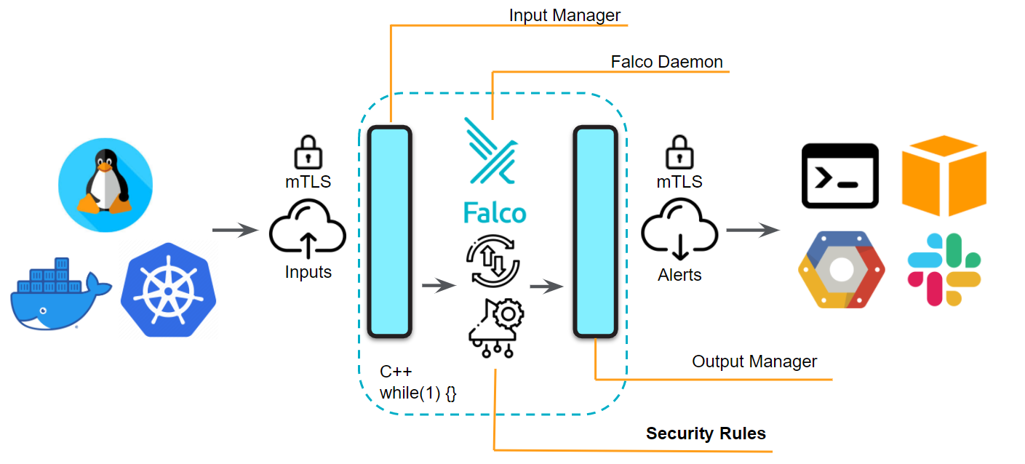
Arquitectura

Slide 4
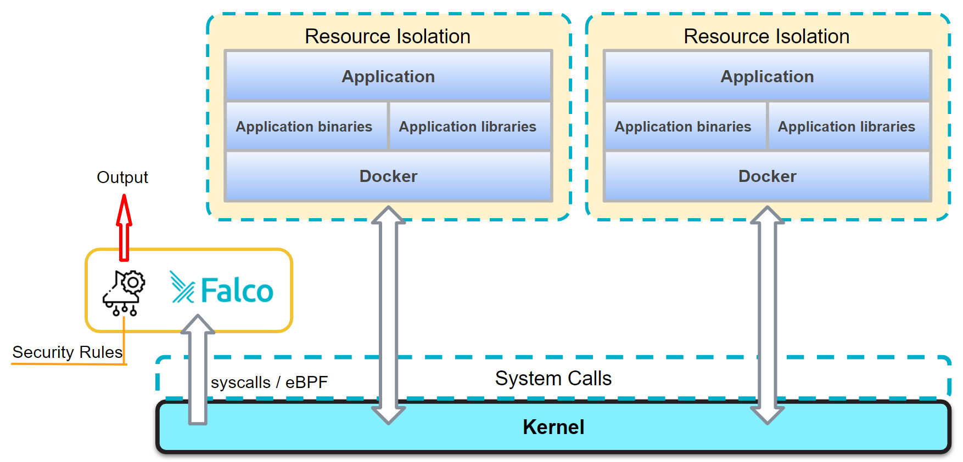

Slide 5
Instalación directa en host

Slide 6
Prerequisitos para practicar
Vagrant : www.vagrantup.com
Virtual Box : www.virtualbox.org
Git : git-scm.com
Repositorio con MV Vagrant con ejemplos de uso de Falco: https://github.com/sysdiglabs/falco-workshop
git clone git@github.com:sysdiglabs/falco-workshop.git

Slide 7
Instalación Debian
https://falco.org/docs/installation
$ sudo apt-get update
$ sudo apt-get -y install gpg curl
$ curl -o install-falco.sh -s \
https://s3.amazonaws.com/download.draios.com/stable/install-falco
$ sudo bash install-falco.sh
# install-falco.sh *equivalent* instructions (sudo):
$ curl -s https://s3.amazonaws.com/download.draios.com/DRAIOS-GPG-KEY.public | \
apt-key add -
$ curl -s -o /etc/apt/sources.list.d/draios.list \
https://s3.amazonaws.com/download.draios.com/stable/deb/draios.list
$ apt-get update
$ apt-get -y install linux-headers-$(uname -r)
$ apt-get install -y falco

Slide 8
Instalación en host mediante Docker
https://falco.org/docs/installation/
# Requiere Kernel de linux compatible
$ sudo apt-get -y install linux-headers-$(uname -r)
$ docker pull falcosecurity/falco
$ docker run -i -t --name falco --privileged \
-v /var/run/docker.sock:/host/var/run/docker.sock \
-v /dev:/host/dev \
-v /proc:/host/proc:ro \
-v /boot:/host/boot:ro \
-v /lib/modules:/host/lib/modules:ro \
-v /usr:/host/usr:ro \
falcosecurity/falco

Slide 9
Configuración de salida, logs y reinicio

Slide 10
$ sudo touch /var/log/falco_events.log
$ sudo nano /etc/falco/falco.yaml
# Cambiar:
file_output:
enabled: true
keep_alive: true
filename: /var/log/falco_events.log
# Reiniciar servicio:
$ sudo /etc/init.d/falco restart
Output targets:
file_output (log file)
gRPC
HTTP output (POST)
syslog output

Slide 11
Cómo probar que Falco funciona
$ su
$ sudo echo "hello" > /var/log/falco_events.log
$ exit
$ cat /var/log/falco_events.log
6:15:59.922240449: Warning Log files were tampered (user=root command=bash file=/var/log/falco_events.log container_id=host image=<NA>)

